Slide 1
Interaksi Manusia dan Komputer (IMK)
THE USER INTERFACE (UI) DESIGN PROCESS
Step 6 Select the proper interaction device
Step – 7 Screen-Based Control

Slide 2
Interaksi Manusia dan Komputer (IMK)
THE USER INTERFACE (UI) DESIGN PROCESS
Step 6 Select the proper interaction device

Slide 3
Tujuan
Setelah mengikuti materi ini mahasiswa dapat:
Mahasiswa/i dapat mampu memahami karakteristik setiap perangkat interaksi sehingga dapat memilih perangkat interaksi yang tepat diterapkan dalam desain UI.

Slide 4

Interaction Device
Adalah suatu mekanisme input atau device yang digunakan user untuk mengkomunikasikan keinginan dan kebutuhannya kepada komputer, dan/atau mekanisme Output atau device yang digunakan komputer untuk memberikan respond kepada user

Slide 5

PEMILIHAN DEVICE
Pemilihan Device yang tepat adalah hal PENTING
Jika tepat maka Performansi Cepat dan akurat. Jika tidak tepat produktivitas turun error naik, STRESS
Notes:
Pemilihan device yang tepat untuk mengakomodir pekerjaan user adalah sesuatu yang sangat penting bagi kesuksesan sistem

Slide 6
CHARACTERISTICS OF INPUT DEVICE
To orient or position an object
To enter or manipulate data or information
To draw something free-form on the screen
To select the object or identify it as the focus at attention
To point at an object on the screen
To drag an object across the screen
To track or follow a moving object

Slide 7
FACTOR OF CONSIDERATION
Discrete VS Continous
Direct VS Indirect
Factor Of Consideration
direction, distance, and speed of movement hand and corresponding pointer

Slide 8
Input Device
Mouse
Trackball
Joystick
Touch screen
Graphic Tablet or Trackpad
Keyboard
Voice
Gesture Recognition
Facial Expression
Eye Tracking device
Fingerprint
Handwriting

Slide 9
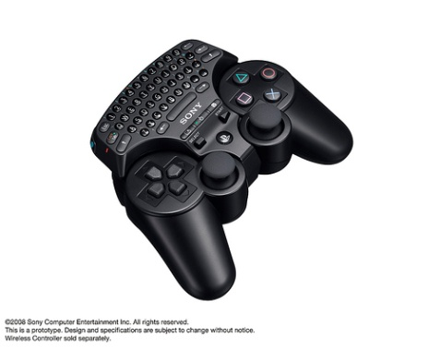

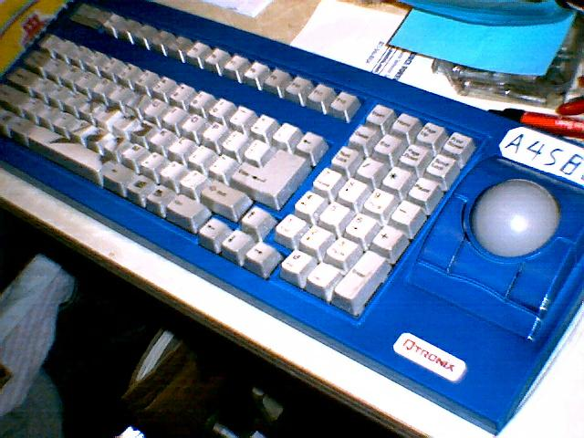
SELECTING THE PROPER INPUT DEVICE

Slide 10
Panduan dalam memilih Input device yang sesuai
Karakteristik Task
Karakteristik User dan preferences
Karakteristik dari environment
Karakteristik dari Hardware
Karakteristik dari device dipandang dari aplikasi yang dibuat/digunakan
Fleksibilitas
Minimalisir pergerakan tangan dan mata

Slide 11
Pointer Guidelines
Pointer :
➔ Harus selalu terlihat
➔ Harus kontras dengan background
➔ Harus memiliki ukuran yang konsisten ketika bergerak
➔ Area Hotspot harus mudah dikenali posisinya
User harus selalu bisa menentukan posisi pointer
Bentuk pointer
Pergunakan bentuk/variasi bentuk dari pointer secukupnya
Berikan kebebasan kepada user saat menggerakkan pointer di dalam layar
Animasi seharusnya tidak:
➔ membingungkan
➔ Mengurangi kemampuan untuk berinteraksi

Slide 12
Output Device
Screen
➔ Image
➔ Color
➔ Size
Speaker
Penggunaan Sound bisa berupa simple beep, speech, music dan sound effect.

Slide 13
CHALLENGES
Analisis kelebihan dan kekurangan masing-masing device di bawah ini:
Trackpad Macbook
Trackpad Windows
Trackball Blackberry
Trackpoint Thinkpad

Slide 14
Interaksi Manusia dan Komputer (IMK)
THE USER INTERFACE (UI) DESIGN PROCESS
Step – 7 : Screen-Based Control

Slide 15
Tujuan
Setelah mengikuti materi ini mahasiswa dapat:
Mampu memilih dan menerapkan screen-based controls yang tepat dengan kebutuhan

Slide 16
Screen Control
Sometimes called ‘widgets’
Widgets: the elements of a screen that constitute its body.
Definition: graphic objects that represent the properties or operations of other objects
Functions:
Permit the entry or selection of a particular value
Permit the changing or editing of a particular value
Display only a particular piece of text, value, or graphic
Cause a command to be performed
Possess a contextual pop-up window

Slide 17
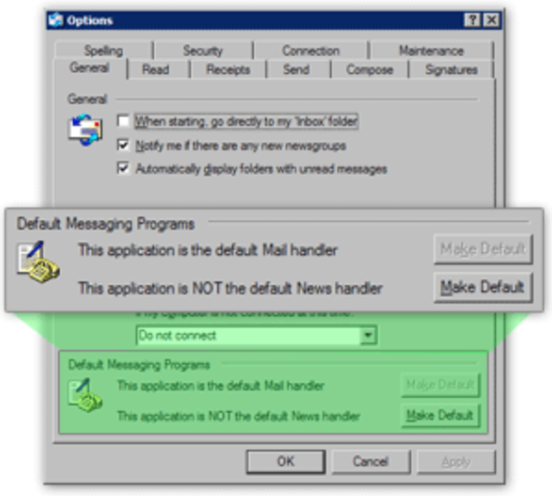
Three Extremely Important Principles
A control must:
Look the way it works
Work the way it looks
“Look” → “enterability” or “clickability”
Used exactly as its design intended
Presented in a standard manner
Example:
Windows XP:
Raised elements can be pressed
Recessed elements can not be pressed
Elements on a flat white background can be opened, edited, or moved.

Slide 18
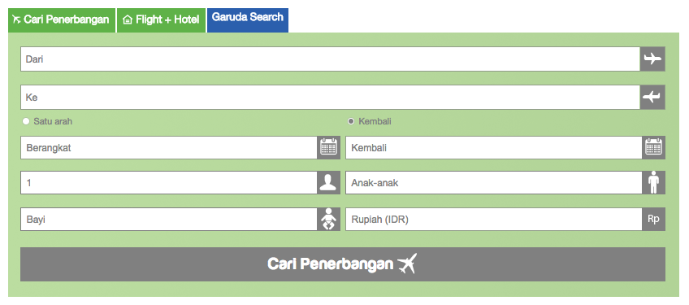
Fact about Web page design
Unleashed and exposed thousands of instances
Basic principles have been violated
Placing greater value on personal creativity than on interface usability

Slide 19
Operable Controls
… are those that permit:
Entry
Selection
Changing
Editing
Cause a command to be performed
Here are the classes… (next slide)

Slide 20

1 – Operable Buttons
Description
A square or rectangular-shaped control with a label inside that indicates action to be accomplished
The label may consist of text, graphics, or both
Purpose
To start actions
To change properties
To display a pop-up menu
There are two kinds:
Command buttons
Toolbar buttons

Slide 21
1 – Operable Buttons
Advantages
Always visible, reminding one of the choices available
Convenient
Can be logically organized in the work area
Can provide meaningful descriptions of the actions that will be performed
Larger size generally provides faster selection target
Can possess 3-D appearance
Adds an aesthetically pleasing style to the screen
Provides visual feedback through button movement when activated
May permit use of keyboard equivalents and accelerators
Faster than using a two-step menu bar/pull-down sequence
Disadvantages
Consumes screen space
Size limits the number that may be displayed
Requires looking away from main working area to activate
Requires moving the pointer to select

Slide 22
1 – Operable Buttons
To a window:
To cause something to happen immediately
To display another window
To display a menu of options
To set a mode or property value
In a web
Use links to show information
Things to consider:
Usage
Structure
Labels
Size
Number
Location & layout
Organization
Intent indicators
Expansion buttons
Default
Keyboard equivalent / accelerators
Button activation

Slide 23
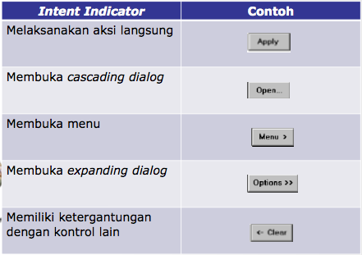
1 – Operable Buttons

Slide 24
2 – Text Entry / Read only controls
Usually referred as “field” or “text-box”
Unprotected: a text box into which information can be keyed
Protected: A text box used for display purposes only
Description
Usually rectangular in shape
Usually possesses a caption or label describing the kind of information contained within it
Two types exist
Single-line
Multiple-line
When first displayed, the box may be blank or contain an initial value
Purpose
To permit the display, entering, or editing of textual information
To display read-only information

Slide 25

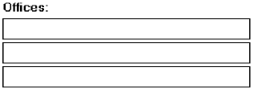

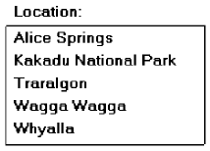

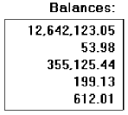

Single occurrence
Multiple occurrence
Or
Read-only / display
Segmentation
If alphanumeric then
left justify
If numeric then right
justify
Or

Slide 26
2 – Text Entry / Read only controls
Advantages
Very flexible
Familiar
Consumes little screen space
Disadvantages
Requires use of typewriter keyboard.
Requires user to remember what must be keyed
Proper usage
Most useful for data that is
Unlimited in scope
Difficult to categorize
Of a variety of different lengths
When using a selection list is not possible

Slide 27
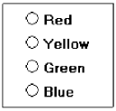

3 – Selection Controls
Presents on the screen all the possible alternatives, conditions, or choices that may exist for an entity, property, or value
Types
Radio button
Check box
Palette
List box
List view control
Drop-down / Pop-up list box
Or

Slide 28
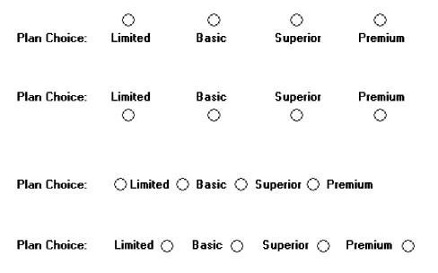
3 – Selection Controls: Radio button
“Only one selection permitted”
Poor
Poor
Poor
Poor
Better

Slide 29
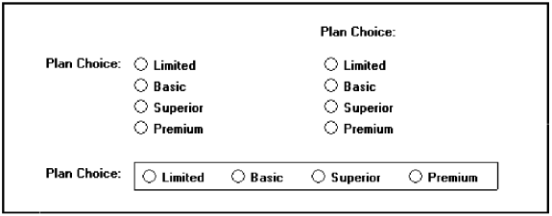
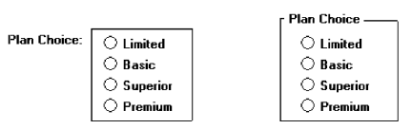

3 – Selection Controls: Radio button
Still better
Best !

Slide 30
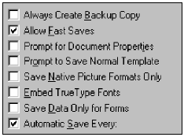
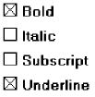
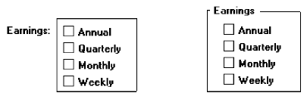
3 – Selection Controls: Check box
“Use for multiple selection”
Best !

Slide 31
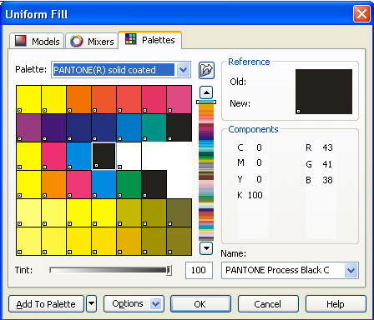
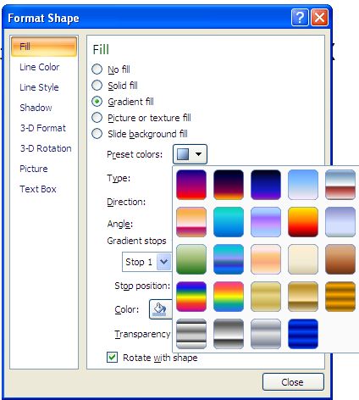
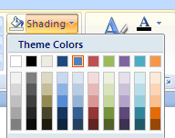
3 – Selection Controls: Palette

Slide 32
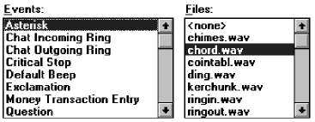
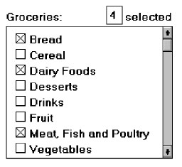
3 – Selection Controls: List box
List box with multiple selection

Slide 33
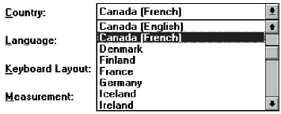
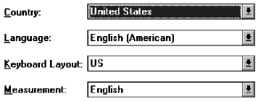
3 – Selection Controls: Drop Down/Pull-down
Then
Droped
Or
Pulled
down
Clicked

Slide 34

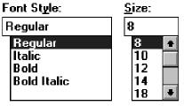

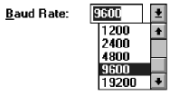
Combination Entry/Selection Controls
Spin boxes
Combo boxes
Combo box - Closed
Combo box - Opened

Slide 35
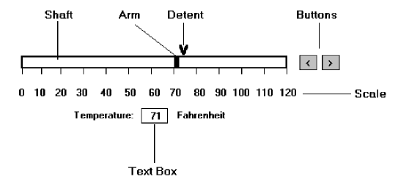
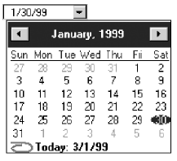
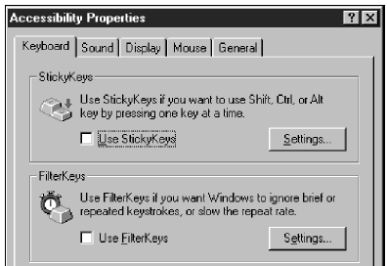
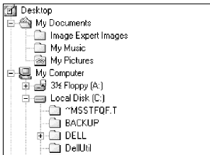
Other Operable Controls
Date picker
Slider
Tree view
Tabs

Slide 36
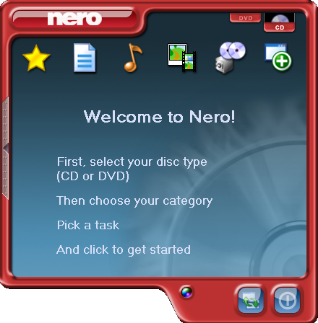
Custom Controls
Implement custom controls with caution
The addition of custom controls adds to this learning and increases system complexity
Images?? Buttons??
Are they clickable?
What is this??
What will happen if
I’m clicking it?
What task?
Where to pick?
I’m sure this are buttons,
Because they looks clickable

Slide 37
Presentation Controls
Static text fields: read-only textual information
Group box: a rectangular frame that surrounds a control or group of controls; optional caption may included.
Column headings: read-only textual information that serves as a heading above columns of text or numbers
Tool tip/balloon tip: a small pop-up window that contains information; could be placed in balloon.

Slide 38
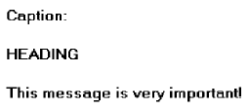

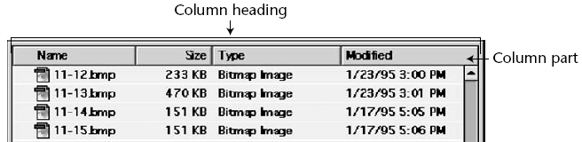
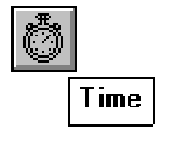
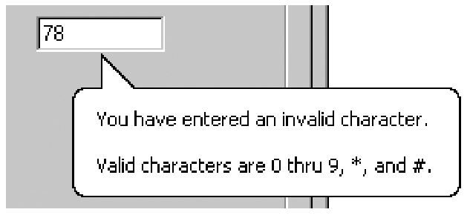
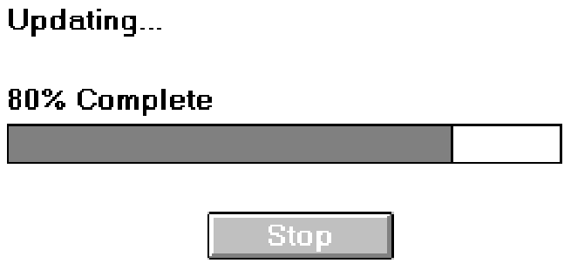
Optional caption
Static text
Tool tip / balloon tip
Progress indicators

Slide 39
Selecting the Proper Controls
Choose familiar controls
Consider the task
Reduce the number of “clicks”
Display as many control choices as possible
When to permit text entry?
Permit text entry if any of the following questions can be answered “Yes”
Is the data unlimited in size and scope?
Is the data familiar?
Is the data not conducive to typing errors?
Will typing be faster than choice selection?
Is the user an experienced typist?

Slide 40
Selecting the Proper Controls
Buttons or Menus for commands?
Consider the following:
Whether or not the command is part of a standard tool set.
The total number of commands in the application.
The complexity of the commands.
The frequency with which commands are used.
Whether or not the command is used in association with another control.

